Slide 1



Inter-SECT Information Session
Linet Mera, PhD
Washington U. in St. Louis Graduate School
While you wait, please Sign in
Notes:
Hello everyone and welcome! My name is Linet Mera. I’m a UCSF PhD Alumna, from the Tetrad program. I started working on this project as a PhD Consultant for UCSF’s OCPD and now work for Washington University in St. Louis Graduate School.
Thank you all so much for being here, you are super important for the success of this project and we are excited to hear your thoughts and comments.
If you haven’t done so already, please sign in

Slide 2
Information session
We will cover
What is Inter-SECT?
Why perform a job sim?
Deliverables Deadlines
What you gain
Notes:
In today’s session I’ll go over these three main topics and we’ll have time for questions.

Slide 3
What is Inter-SECT?
Interactive Simulation Exercises for Career Transitions
A workbook of job simulation exercises to prepare grad students and postdocs for careers beyond the bench
Helps graduate students and postdocs learn about a job
User end goal: Decide whether to continue pursuing a career of interest
Funded by Burroughs Wellcome Fund
Notes:
What is INTER-SECT?
1- It stands for Interactive Simulation Exercises for Career Transitions
2- The INTER-SECT workbook will provide true-to-life job simulation exercises to help prepare trainees for careers after academia.
3- The core purpose of the workbook is to help graduate students and postdocs learn about a job through experiences.
4- And after completing a job simulation, we hope that YOU (grad students and postdocs) will be able to decide if you’d like to further pursue that career field, and whether you want to commit time and energy to find an internship or take additional training like a certification or courses.
5- The project goal is to provide a library of job simulations that graduate students and postdocs around the US can access at any institution.
6- We are doing this by collaborating with faculty and career staff at other institutions across the nation.
7- All of this is possible through a grant from the Burroughs Wellcome Fund
8- Okay, I underlined nationwide, let me tell you why that matters. The last resource that Thi (the founder and co-creator of this project) built for grad students was SO successful- it got picked up by Stanford, Harvard, Yale, Sloan Kettering, and UT South Western. Your input is going to impact hundreds maybe thousands of graduate students and postdocs!!
** called Business concepts for life scientists

Slide 4
The Inter-SECT Experience
To job sim experience comprises more than the task:
Complete a job simulation
Complete a self-reflection sheet on the simulation
Interview a professional (informational interview)
Notes:
What is your role in the project?
Your role in the project is essentially user experience
1- Complete a job simulation on a career that interests you
2 -Complete a self-reflection sheet on the simulation
3- Conduct an informational interview with a professional in that field
4- Provide us feedback on the experience as a whole
For this round of beta testing, we have a specific timeline and schedule we need to meet in order for us to reach our expected completion date for the project.

Slide 5

Timeline
1-3 week timeline
We suggest completing the job simulation experience in 1 to 3 weeks
Performing the job sim task should take about 4-8 hours to complete
Past participants shared:
  Connecting with professionals was a time consuming part of the experience
  Setting deadlines helped participants to complete the experience
Notes:
Our project goal is to complete the first wave of beta testing by early February
1- This translates into a week from today to the day when you complete the overall experience evaluation.
2- This can seem like a lot, but remember, the bulk of the time you spend on this experience will be the job simulation itself which we expect will take up to 6-8 hours to complete, in some cases just 3-4 hours. And you can tackle it this weekend!
3- Plus nothing needs to be perfect, all we really want is just your impression on the experience.
4- It’s okay if you can’t commit right now to a one week timeline, if you can get us the comments on clarity and time to completion in two weeks, it will be helpful to us!
So, with this timeline in mind, let’s take a look at what you’ll be working on

Slide 6
Documents and deliverables
5 documents and deliverables:
Job simulation*
Self-Reflection Sheet*
Project SMART Goals
Informational Interview Guide
Evaluations*
Notes:
There are 4 straightforward, main documents you will use during the beta-testing. We’ll go into more detail into each one in the coming slides.
Job simulation
Self-Reflection sheet
Project SMART Goals
Informational Interview Guide
Evaluations
The asterisks are for the things that are mandatory to complete and send back to us.
You’ll need to review all the documents before you get started on the simulation so you have an idea of what’s ahead of you.

Slide 7

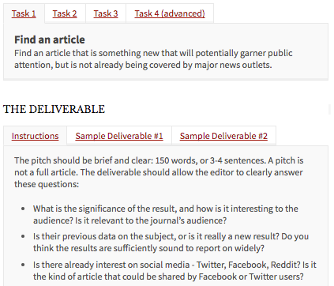
1. Job Simulation
Provides task details. Download from the website.
Notes:
The Job simulation will provide task details and you can download it from the website we’ll send to you today.
This is what the website looks like on the left hand side and this is what a job simulation will look like on the right.
1- We designed the job simulation to be self-explanatory and contain all the info you need to complete the task. But if it’s not self-explanatory – that’s where we need your feedback.
2- A simulation will contain directions for what type of deliverable, AKA what you need to complete when you’re done and resources for you to use if necessary.
3- Everyone will send us their completed job simulation- Don’t worry it’s not homework! Nothing needs to be perfect, we just want to see how you tackled it and your feedback on it. We’ll anonymize your completed simulation to use as an example for other institutions and trainees.

Slide 8
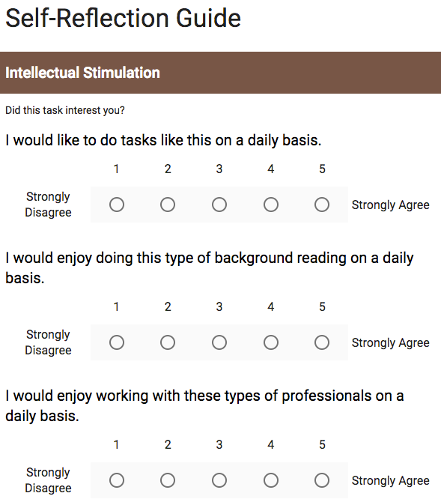
2. Self-Reflection Sheet
Helps you decide if you want to pursue a career.
Fill out online.
Google form for you to fill after you complete the simulation.
Important to familiarize yourself with this form before starting the simulation – check the downloadable .pdf version.
Keep in mind that we’ll ask you questions on content and format of the self-reflection sheet.
Notes:
The Self Reflection Sheet is a Google sheet that you will fill out AFTER you complete the job simulation.
1- The goal of the self-reflection sheet is for you to be able to determine if you want to spend more time exploring this career. If the job simulation sparked curiosities you’d like to follow up on or if you’re no longer interested in the field.
2- It is important, however that you become familiar with the self-reflection sheet BEFORE starting the simulation as it will guide you on what to keep in mind during the simulation.
3- To successfully complete the self-reflection sheet, you will broadly identify how the job simulation fit your skills and interest.
4- Keep in mind, that in the overall evaluation survey at the end of the testing we’ll also ask you for feedback about this sheet.
5- Content-wise we’ll ask things such as – were there questions that were hard to answer even after you completed the job simulation? What other questions arose as you completed the simulation that we should have included in the self-reflection sheet?
6- Format-wise: Did you have enough space to write in your answers? Did you like the table format, for example.
This document is in a Google spreadsheet along with..

Slide 9
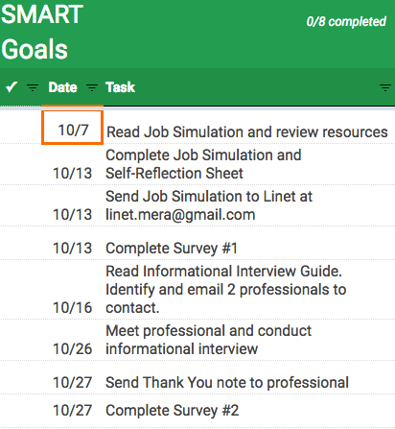
3. Project SMART Goals
To help you keep on task.
Download a copy.
For you to fill throughout the beta testing.
A tool for you to break down the major components into tasks.
Notes:
The Project SMART Goals
1- If you don’t know what a SMART goal is, it’s explained in the document.
2- This document will help you keep track of the timeline and your deliverables.
3- It’ll give you a suggested timeline that you can adjust as needed.
Let’s go through the general tasks and timeline
After today you’ll get a survey link that I’ll use to send you your job simulation components on Friday.
You will have until the next day to get familiar with all the documents
1 week from this Friday to complete the job simulation and self reflection sheet. At this point you’ll email the simulation to me and complete the first survey
- Around the time you turn those in, you’ll also identify 2 professionals to contact for an informational interview (this is to increase your chances of getting an appointment with them)
Then you’ll have an extra 2 weeks just for scheduling and carrying out the informational interview. Most of our trainees from the first round of beta testing were able to secure an informational interview in under 2 weeks so this should be plenty.

Slide 10
3. Project SMART Goals
To help you keep on task.
Google sheet.
If you have any trouble contacting a professional, use the MINDBank, or contact Gabi and Stephen
Notes:
We know scheduling informational interviews can be tough, so when you get to the task I’ve highlighted here please check in with me to let me know how scheduling the informational interview is going. This is important because I’ll be able to offer extra support if you haven’t been able to pin down a professional by this point.
- Lastly, once you’ve done the simulation, completed the self-reflection sheet, and interviewed a professional, you’ll complete an overall experience evaluation where you get to tell us what you think about the whole thing.
-These are all necessary tasks but it is a suggested timeline. You could always get a jump start on trying to schedule an informational interview by emailing professionals before you complete the job simulation.
If you have any questions throughout the process, just shoot me an email.

Slide 11
3. Project SMART Goals
To help you keep on task.
Google sheet.
If you have any trouble contacting a professional, use the MINDBank.
Complete brief evaluations
Notes:
We know scheduling informational interviews can be tough, so we’ve also created a task I’ve highlighted here where you check in with me to let me know how scheduling the informational interview is going. This is important because I’ll be able to offer extra support if you haven’t been able to pin down a professional by this point.
Lastly, once you’ve done the simulation, completed the self-reflection sheet, and interviewed a professional, you’ll complete an overall experience evaluation where you get to tell us what you think about the whole thing.
Please note there are TWO surveys and they’re both essential parts of the beta-testing
-These are all necessary tasks but it is a suggested timeline. You could always get a jump start on trying to schedule an informational interview by
If you have any questions throughout the process, just shoot me an email.

Slide 12
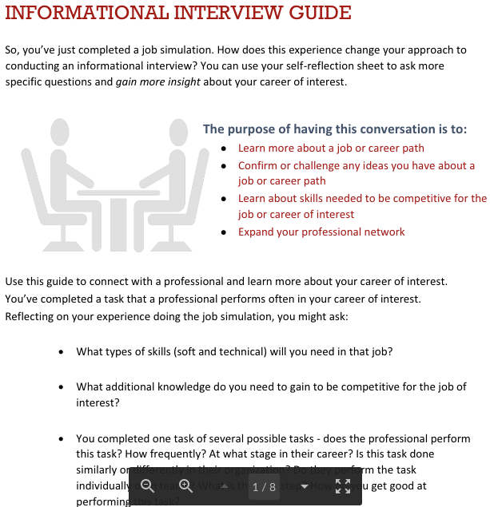
4. Informational Interview Guide
A “How-To” on informational interviews. Also on the website.
What to expect and what questions to ask.
How to set up an informational interview and end one.
Interview etiquette
Contact more than one professional when you’re ready for informational interviewing.
Notes:
Who here has done an informational interview? Great!! For those that haven’t, and those that need a refresher, this document is for you.
This document will cover:
What to expect
What types of questions to ask
How to set up an informational interview
How to close an informational interview
Interview etiquette, including the thank you note.
You will be contacting more than one professional to interview for your specific job simulation.
For example, if you chose to do the Medical Writing job simulation, you will reach out to a Medical Writer to conduct an informational interview.
Since we’re dealing with a short timeline, it’s best if you contact more than one professional when you’re ready for this step.
If you complete the job simulation and find out that this particular career doesn’t fit what you’re looking for, you may not think it’s useful to conduct an interview. However, we recommend you do one anyway to determine if the reason you’ve decided against the career is valid. For example, if you did a business development job simulation and found out you didn’t like it, you may ask a professional in the field whether they perform that type of task all the time. They may tell you that you’re only really doing tasks like that the first 6 months.
Remember that there the OCPD has lots of resources for you such as workshops, one on one mini and hour long meetings, a bunch of stuff online as well!
***** Please ask the professional after you’ve completed the interview whether they’d be open to be contacted by other trainees ************
******** LinkedIn is your friend. How many people here are from the MIND program? You can use MINDBANK for this section **************

Slide 13
5. Evaluations – survey questions
Feedback on your experience as a whole
A place for you to tell us how you liked the experience from start to finish and whether you thought it was useful
Notes:
This survey will help us collect your feedback on the overall experience.
It will be in a survey format much like your registration for beta testing
You can tell us what you liked and didn’t like about the smart goals, the reflection sheet, the sim, and the informational interview.
This will be really important as it will help us shape how we and other groups run future test of job simulations and the process of crafting them.
You absolutely must complete this, Thi will hound you until you do!

Slide 14
Careers
Beta-testing 9 job simulations in 6 career categories
Clinical Research Coordinator
Science Outreach & Education
Program Management
Science Journalism
Regulatory Affairs
Technology Management
Notes:
We’ve split the careers we’re focusing on into two waves of testing:
The first group of testers which will test Medical Writing, Freelance Science Journalism and Business Development
You’re in the second round of testing and will test Intellectual Property, Science Policy, and Program Management.

Slide 15
What you gain from this experience
You’ll learn a lot about these careers and about yourself!!
You’ll find out what types of ways you like to search for information.
  Google, bioRxiv, scanning clinical trials.
You’ll find your niche within a career
  Maybe you love diving deep into FDA nuances?
Do you like planning events or do you prefer to read up on technology?
How to talk to patients in a clinical trial versus coordinating one.
All can factor into deciding what type of job you want to pursue!
Notes:
You’ll find out what types of ways you like to search for information.
Google, bioRxiv, scanning clinical trials.
You’ll find your niche within a career
Maybe you love diving deep into FDA nuances?
Do you like planning events or do you prefer to read up on technology?
How to talk to patients in a clinical trial versus coordinating one.
All can factor into deciding what type of job you want to pursue

Slide 16
Summary
The Inter-SECT project will culminate in a library of job simulation workbooks to prepare trainees for careers beyond academia.
You are the critical first step in this process!
You will have 4 deliverables:
  Job simulation
  Self-reflection sheet
  2 Evaluations
We will provide you with the resources you need to complete them.
Can you commit to a 3 week timeline starting 10/7?

Slide 17

UCSF OCPD Resources
Workshops
One-on-one coaching
Online materials and more!!
career.ucsf.edu
Notes:
I want to thank the folks at MIND for partnering with us in the information session and providing excellent support.
QUESTIONS
Does anyone have any questions on the material I just went over or questions in general about the project?
{AFTER ANSWERING QUESTIONS}
Keeping the timeline in mind, I will go through the attendees who checked in. When I read your name, please tell me if you can commit to the 3-week timeline.

Slide 18
Career fields
18 job simulations in 10 career categories. Here are a few.
Clinical Research Coordinator
Coordinating a Clinical Trial Schedule
Responding to Patient’s Questions
Science Outreach & Education
Developing Educational Resources
Event Planning
Evaluating a Program
Program Management
Crafting a Scope of Work
Science Journalism
Making an Editorial Decision
Regulatory Affairs
Completing a Competitive Analysis
Technology Management
Market Analysis
Notes:
We’ve split the careers we’re focusing on into two waves of testing:
The first group of testers which will test Medical Writing, Freelance Science Journalism and Business Development
You’re in the second round of testing and will test Intellectual Property, Science Policy, and Program Management.

